Slide 1

Calorie Calculator
Project Mania
Reboot 2014

Slide 2
Calorie and it’s Intake
Calorie: A measure of the amount of energy derived from food
Calorie Intake: the total number of calories in a daily diet allocation .
Calorie In: Everything we eat and drink contains calories. With the exception of obvious stuff like water,
Calorie Out: Everything we do burns calories. They are what our bodies use for energy to do everything we need to do.

Slide 3
Calorie Calculator
Application’s Description
Calorie Calculator is a optimized and User friendly and a very strong tool to calculate and record daily calorie Intake. It is the World’s First desktop Fitness Tracker, including the most sophisticated Calorie Counter for regional foods.

Slide 4
Start Using Calorie Calculator
Paste Unzipped “Calorie calculator”(A folder) In C drive of Your System.
Install “dotNetFx45_Full_setup.exe” present “C:\calorie calculater”
Double Click on “calorie calculator.exe” to Start Calorie Calculator Windows Application.

Slide 5
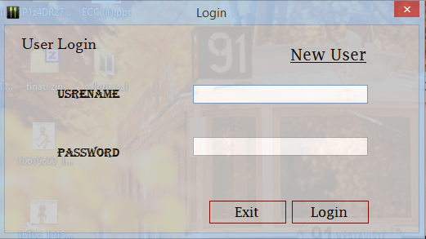
The Main Login Screen

Slide 6
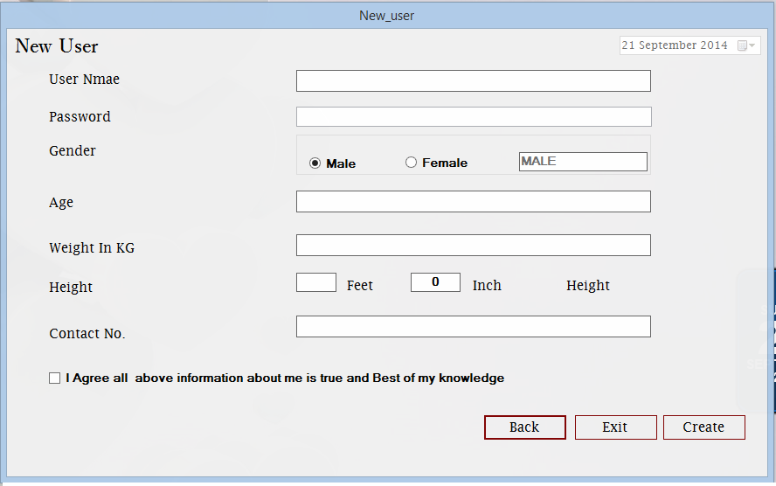
New User Registration

Slide 7
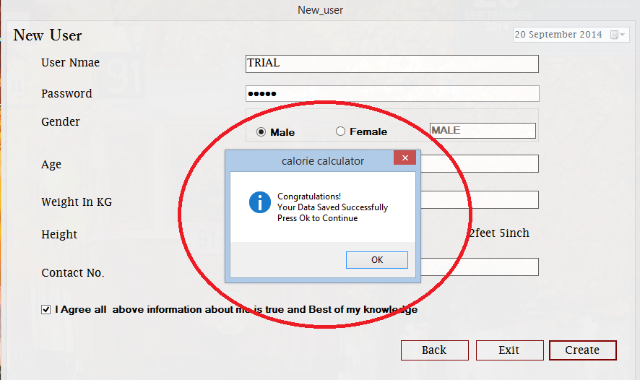
Confirmation message

Slide 8
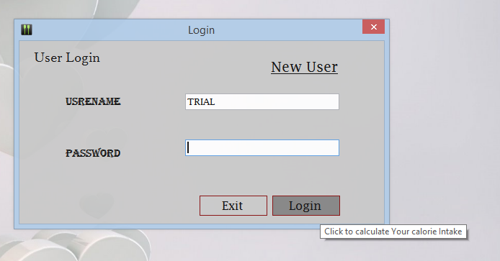
Now Login to continue

Slide 9
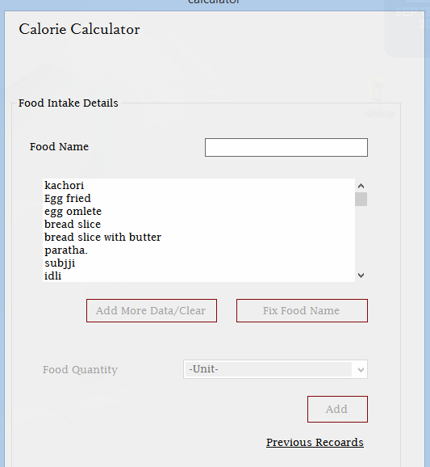
Calculator Interface

Slide 10
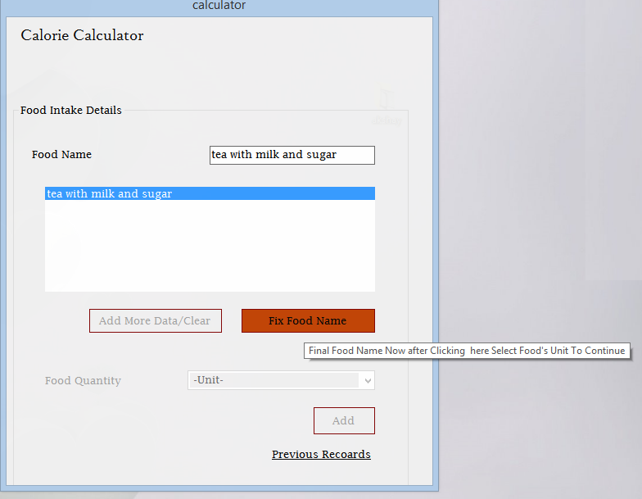
Food Selector

Slide 11
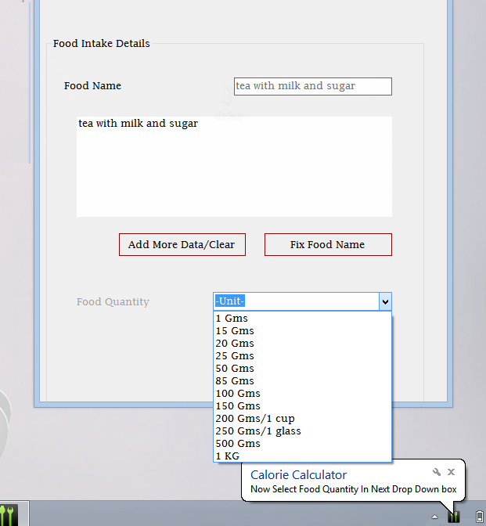
Unit Selector

Slide 12
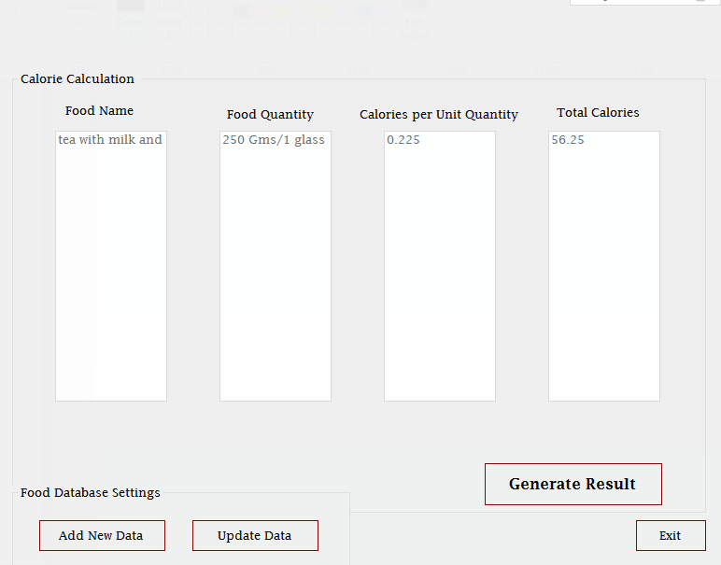
Calculation table

Slide 13
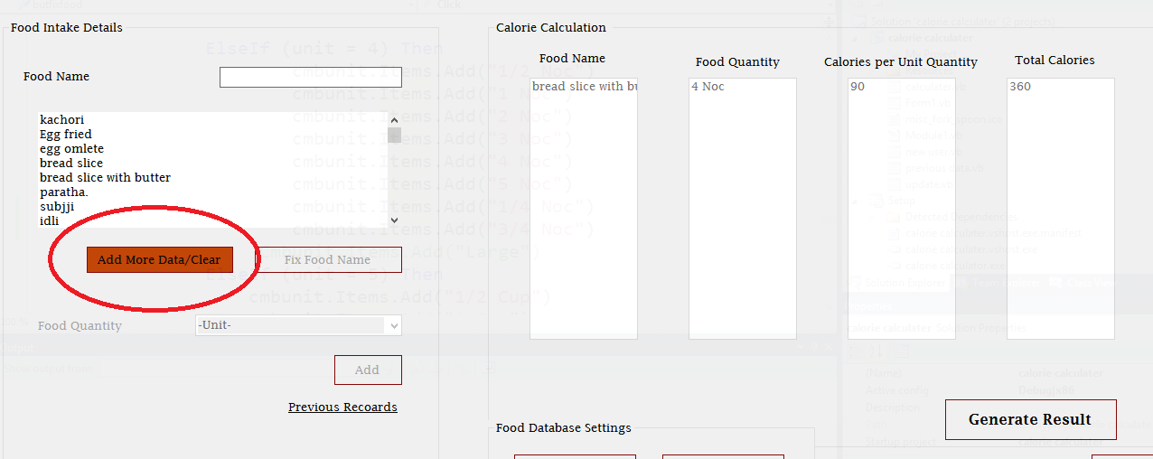
Add more data/Clear Selected data

Slide 14
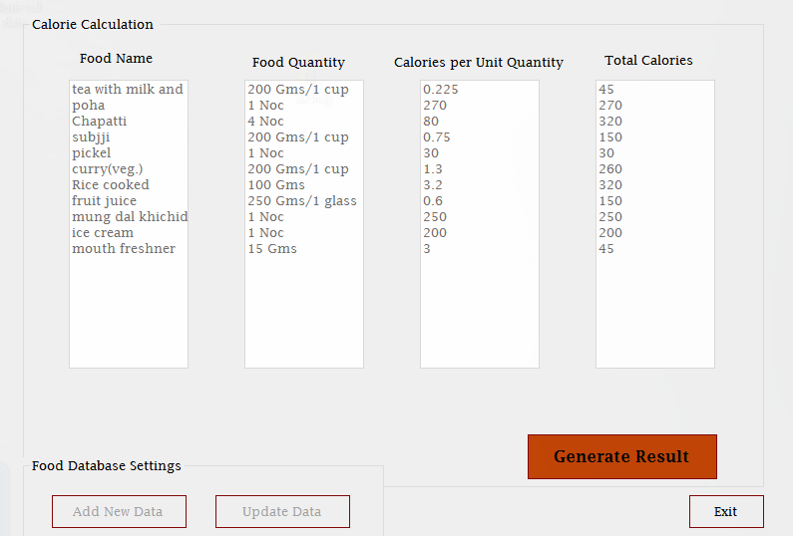
Result generator

Slide 15
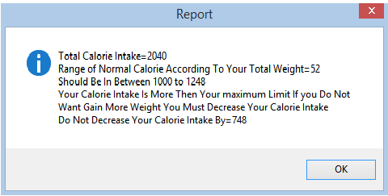
Generated Result

Slide 16
Administrator Account
An administrator account is a user account that lets you make changes that will affect other users.
The user who register first will be Administrator of this windows application on that particular machine.
In this windows application Administrator will be able to make Food database changes.

Slide 17
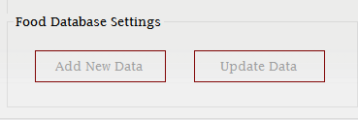
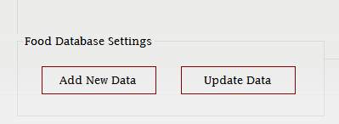
Option enabled for Admin
Special options for Administrator
Option disabled for normal user

Slide 18
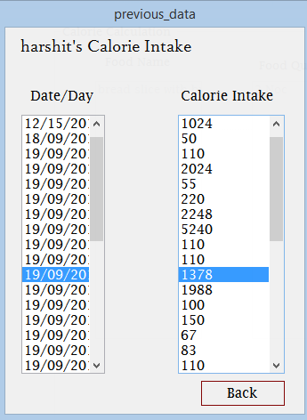
Previous data/History

Slide 19
Why to Use this calorie calculator
To estimate the number of daily calories your body needs to maintain your current weight.
To maintain our daily food intake.
Keeping records of previous calorie intake.

Slide 20
Unique Features
Special Sound effects.
Food Selection list box to search food name.
Press “Esc” to Quit(/Move Back) from form.
Powerful enough to enter all data without using mouse just by using Enter key(keyboard).
First fully offline windows application to calculate calorie intake as well generate result.
Light , Fast and well optimized

Slide 21
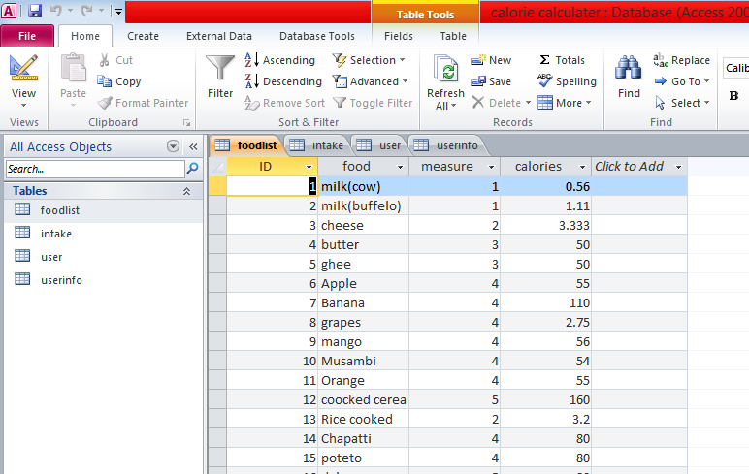
Database Overview

Slide 22
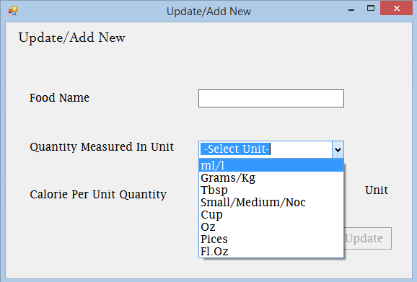
Measuring units used

Slide 23
Software used
Microsoft visual studio 2010
Microsoft Access 2010
Paint

Slide 24
Now Look Up to the software

